Slide 1

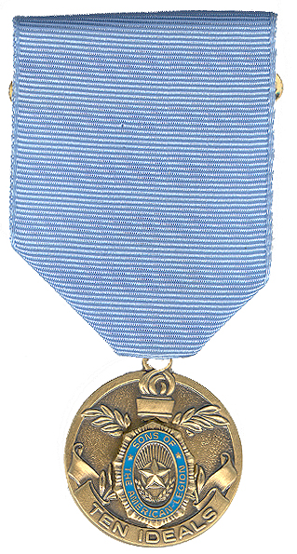
The Ten Ideals
Sons of The American Legion

Slide 2

The Ten Ideals
Patriotism
Health
Knowledge
Training
Honor
Faith
Helpfulness
Courtesy
Reverence
Comradeship

Slide 3
Patriotism
Patriotism is commonly defined as love of and/or devotion to one's country.
  Examples of Patriotism :
    Turn out for Memorial Day. Independence Day & Veterans Day parades & ceremonies.
    Learn the proper display of the Flag
    Learn the “Pledge of Allegiance”

Slide 4
Health
Write an essay on how to maintain sanitary conditions to promote health in :
  Your home
  In the Post home (give examples of sanitation and safety standards in your Post home)
  In Camps & Outdoors in general (explain what you do daily to keep it.)

Slide 5
Training
Become a Squadron Officer, or assist a Squadron officer(s) during and between meetings and activities.

Slide 6
Knowledge
Knowledge is defined as the state or fact of knowing. Familiarity, awareness, or understanding gained through experience or study.
  Maintain a passing mark in school.
  Know the instructions for the ten ideals and five points of service. Explain what each individual part means. This may be written or oral.
  Know what the SAL Emblem stands for. Explain orally what each part of the Emblem stands for. If possible, use an Emblem which comes apart so that the Emblem can be put together as it is being explained.

Slide 7
Honor
Honor is defined as high respect, as that shown for special merit.
  Honorable service in the Squadron over a period of six (6) months shall qualify you for this award.
  Honesty of actions and purpose, and truthfulness will help you achieve this.

Slide 8
Faith
Faith is defined as a confident belief in the truth, value, or trustworthiness of a person, idea, or thing. Belief that does not rest on logical proof or material evidence
  Good conduct and willingness to obey instructions over a period of six months will earn the Squadron’s recognition of your faith in its leadership and ideals

Slide 9
Helpfulness
Helpfulness is defined as providing assistance; useful.
  Develop reasonably consistent attendance at meetings and other functions.
  Volunteer for tasks for the good of the Squadron and be reliable in carrying out your part.
  Help promote your Squadron by signing up at least one new member, and help collect dues from existing members.

Slide 10
Courtesy
Courtesy is defined as polite behavior.
  Apply yourself diligently to show you are polite and respectful to your comrades, officers, Legionnaires and others with whom you come in contact.

Slide 11
Reverence
Reverence is defined as feeling of profound awe and respect; venerate. An act of showing respect.
  Be active in your local religious organization of choice.
  Assist the Post in placing flowers and/or flags on Veterans graves.
  Assist your Post/Squadron Chaplin during services or ceremony.

Slide 12
Comradeship
Comradeship is defined as the state of being a comrade, intimate fellowship. The company, friendship or fellow purpose of others.
  Show the tie that binds you to the Squadron and to the American Legion by helping in the American Legion programs.; thus aiding Disabled Veterans (e.g. Annual Poppy Sale, Gift to Yanks, Blood Drive)
  Help cheer some Veterans in a hospital or in his home.

Slide 13
The Ten Ideals
A National Award of recognition may be presented to those who have completed the Ten Ideals Program.
This medal is available through :
National Emblem Sales, The American Legion, PO Box 1050 Indianapolis, Indiana 46206.

Slide 14
The Ten Ideals
Sons of The American Legion

